Slide 1





Slide 2
Data-Driven Diagnosis: A Machine Learning Approach to Diabetes Detection
Allyn Christian I. Quiamjot

Slide 3
Diabetes Statistics
~537 million people worldwide suffers from diabetes (10.5% of population) according to International Diabetes Federation
11.3% of total population will develop diabetes by 2030
Medical tests are expensive and subject to availability
Is there an alternative way to predict/diagnose diabetes?

Slide 4
Logistic regression
Random forest classifier
Returns probability (0 to 1) of belonging to a class based on a linear combination of features
Computationally cheap
Performs well when features and target have linear relationship
Prioritizes interpretability
Predictions are based from multiple decision trees
Computationally expensive
Prone to overfitting if not properly tuned
Prioritizes accuracy

Slide 5
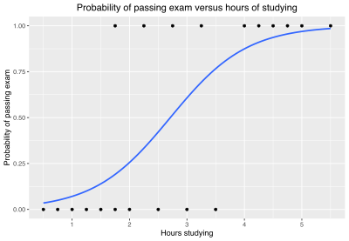
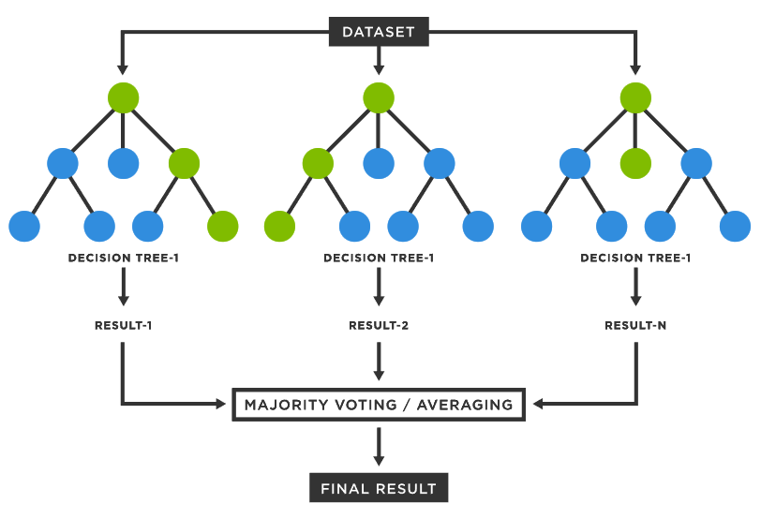
Logistic regression
Random forest classifier

Slide 6
methodology
Logistic Regression
Evaluate accuracy, specificity, and sensitivity
Dataset
Split into training and testing set
Test on custom parameters
Random Forest Classifier

Slide 7
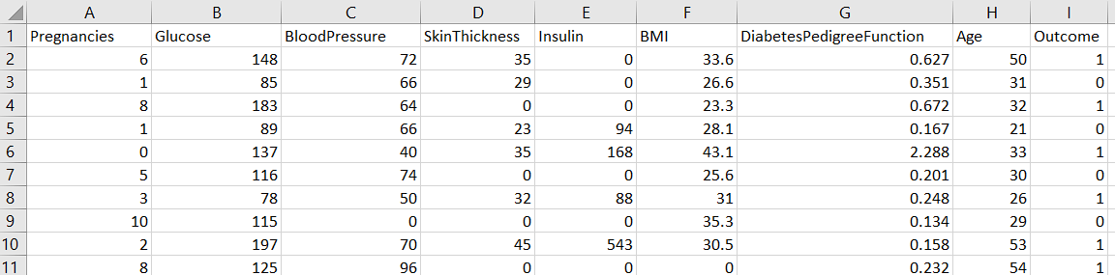
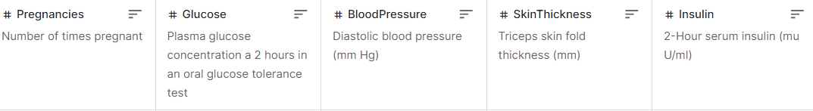
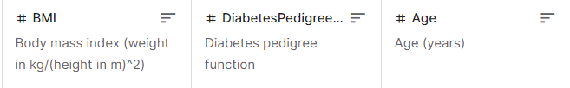
768 samples, females, >21 years old
Pima Indians Diabetes Database. Retrieved from https://www.kaggle.com/datasets/uciml/pima-indians-diabetes-database

Slide 8
RESULTS

Slide 9
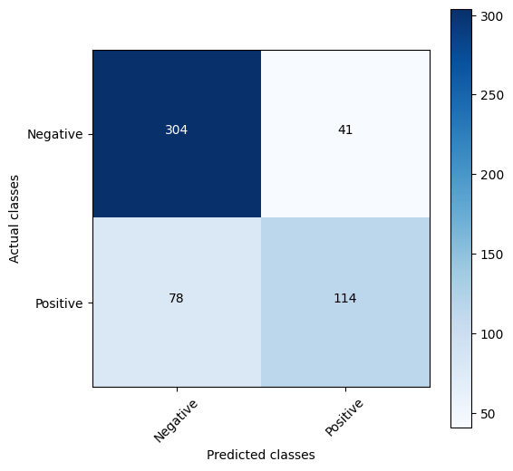
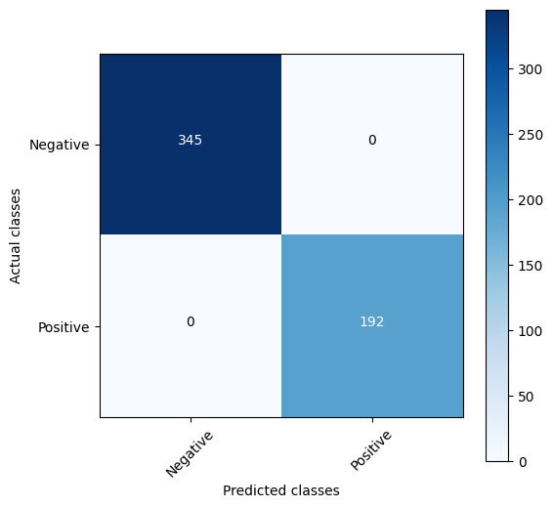
Logistic regression
TRAINING
Random forest classifier
Accuracy: 77.84%
Sensitivity: 59.38%
Specificity: 88.12%
Accuracy: 100%
Sensitivity: 100%
Specificity: 100%

Slide 10
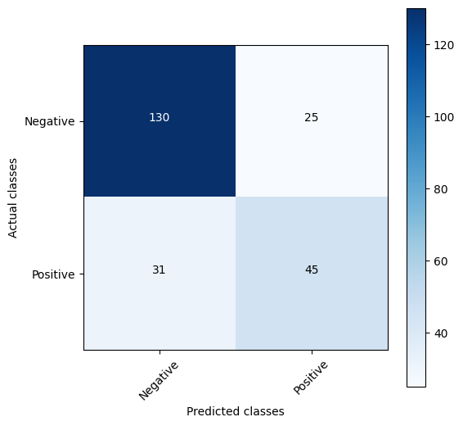

Logistic regression
TESTING
Random forest classifier
Accuracy: 75.76%
Sensitivity: 59.21%
Specificity: 83.87%
Accuracy: 76.19%
Sensitivity: 61.84%
Specificity: 83.23%

Slide 12
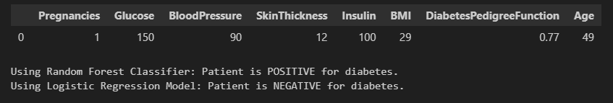

Slide 13
Moral of the story: eat healthy, live healthy

